Slide 1
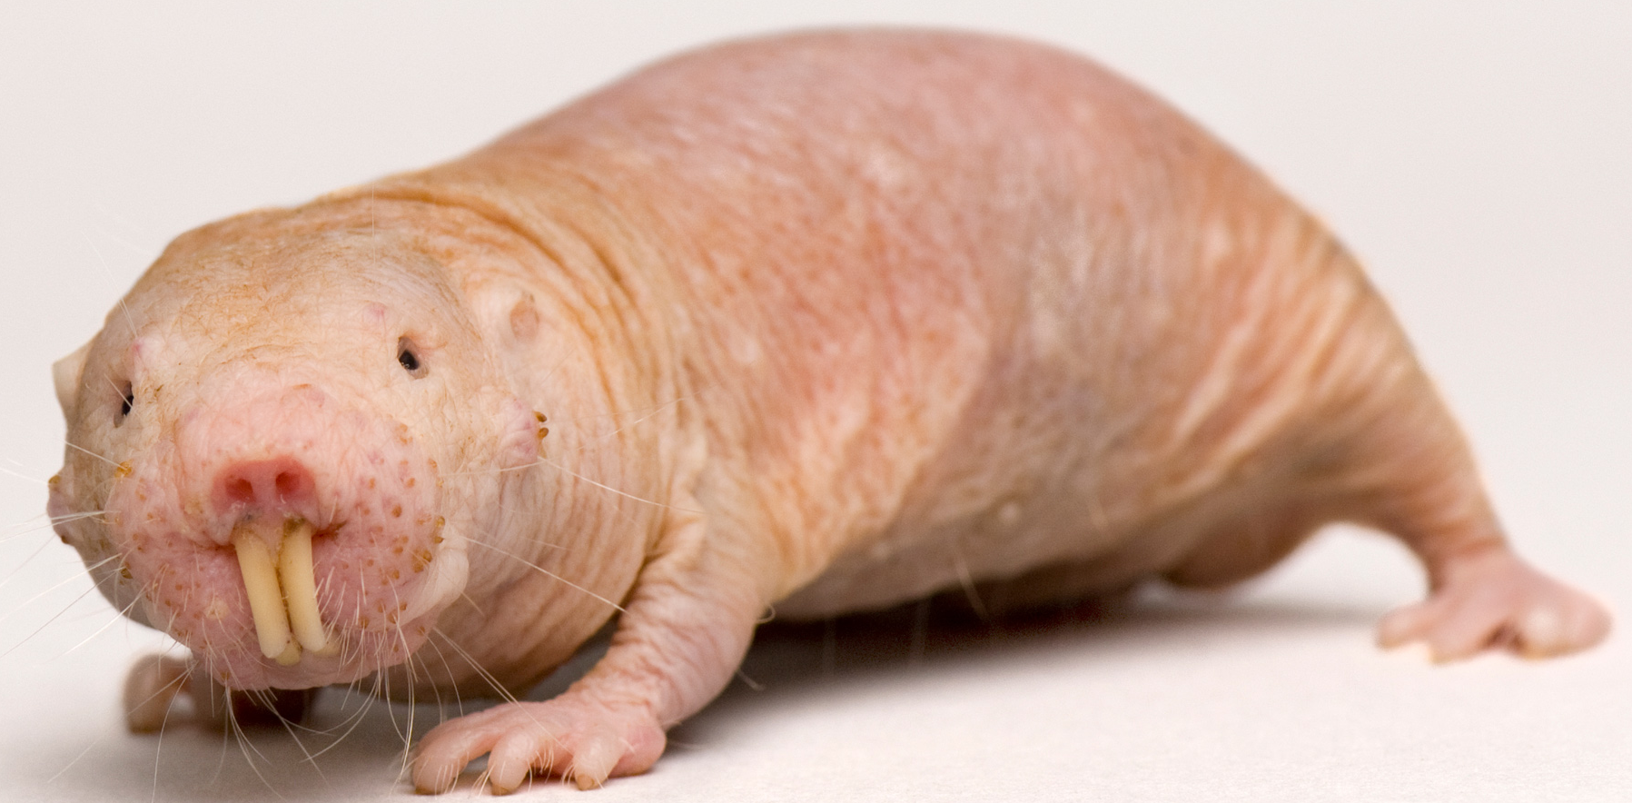
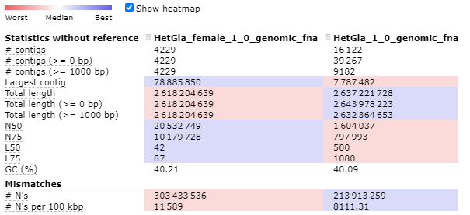
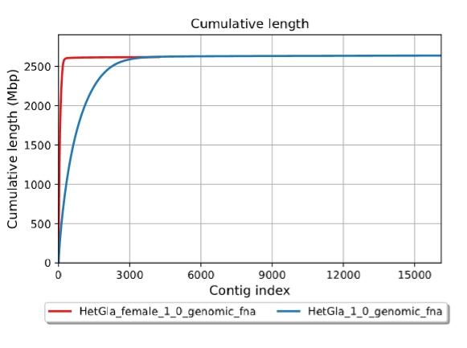
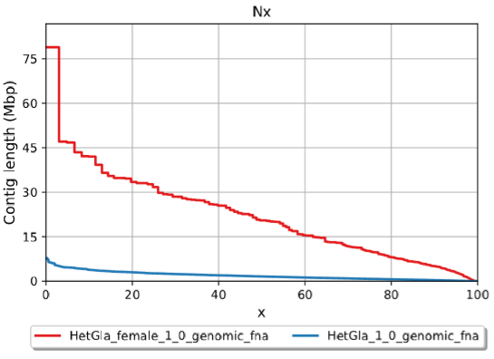
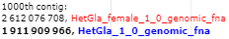
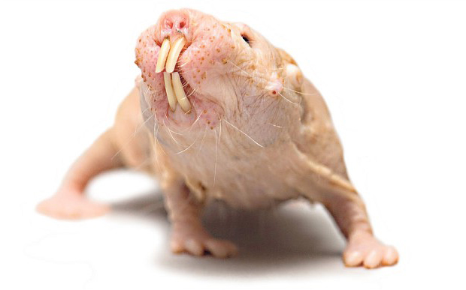

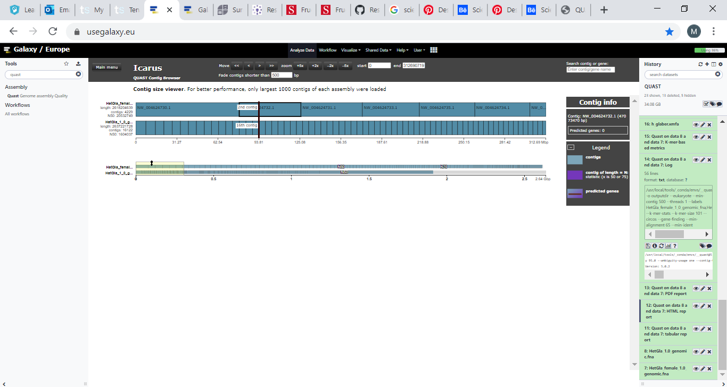
Goals for a new reference-grade de novo assembly: A comparative study between existing naked mole-rat genome assemblies and the future of de novo genome assembly of the naked-mole rat
Mohammed Bilal | The University of Bradford
The naked mole-rat (Heterocephalus glaber, NMR) is the longest-lived rodent with a maximum lifespan of >30 years¹.
NMRs can tolerate periods of extreme hypoxia and 18 minutes of complete O₂ depravation without any ramifications².
NMRs are ideal model organisms for aging and cancer research³.
For researchers to fully understand NMRs, an adequate genome tool is required from which they can draw data from in order to uncover the molecular basis of the extraordinary NMR traits. Two groups have separately published draft genome assemblies of an individual naked mole-rat^{3,4}.
GLOBAL STATISTICS FOR NMR GENOMES
‘Assembly_1’ – by Kim et al, (2011) 92x/contig N50: 19.3Kb/scaffold N50: 1.6Mb³
‘Assembly_2’ – by Keane et al, (2014) 90x/contig N50: 47.8Kb/scafN50: 20.5Mb⁴
To encapsulate the current state of the naked mole-rat genome assemblies.
To critically assess the quality of the published naked mole-rat genomes using QUAST⁵ – an quality assessment tool for assessing genomes.
To create a full bioinformatic pipeline outlining major steps for a new reference-grade de novo genome assembly using published Illumina/PacBio reads and software assemblers (1) ABySS, (2) Velvet (3) SPAdes to generate an improved genome assembly for the naked mole-rat.
*Kb-Kilobase, Mb-Megabase
INTRODUCTION
OBJECTIVES
METHODS
QUAST is a QUality ASsessmenT tool for evaluating and comparing genome assemblies⁵. For this study, the web based platform ‘Galaxy’ (for biomedical research; EU server) will be used to run QUAST. Below is a list of steps in order to evaluate the quality of the published HetGla_1.0³ and HetGla_female_1.0⁴ naked mole-rat genomes via. QUAST.
Step 1: Import the NMR dataset(s) into the web based platform ‘Galaxy’ in .fna (FASTA) format. Note: Use the command ‘$gunzip’ to decompress files.
Download NMR genomes from: https://www.ncbi.nlm.nih.gov/assembly/?term=Heterocephalus+glaber.
Step 2: Click on the QUAST genome assembly quality tool (Galaxy Version 5.0.2) in the search box and select the two NMR assemblies for QUAST analysis.
Step3: Select ‘Execute’ and wait for the QUAST analysis to finish. Note: Wait times depend on the Galaxy.EU server
Step4: View the outputs files from QUAST analysis, they include: (1) Tabular report, (2) HTML report, (3) PDF report, (4) .txt file (log).
RESULTS
CONCLUSION
QUAST – Quality Assessment Tool
1. Male and Female NMR Assembly Statistics
Performance and completeness for a de novo (non-reference guided) genome assembly is presently measured by its N50, the greater the N50 the more accurate the assembly⁶. The female assembly (HetGla_female_1.0) outperformed the male assembly (HetGla_1.0) for N50.
A further metric for gauging genome assembly qualities is L50. L50 is defined as the minimum length of all scaffold that together account for 50% of the genome⁷. The female assembly (HetGla_female_1.0) outperformed the male assembly (HetGla_1.0) for L50.
Contiguous sequences from the female NMR assembly appear to be larger in length (Figure 3) and have higher base counts within the contigs (Figure 2). The ICARUS visualisation (Figure 4) confirms the larger contig length for the HetGla_female_1.0 assembly.
Future Research
To build a new reference-grade de novo genome assembly for the NMR.
The research question will be: “Working with publushed Illumina/PacBio sequencing data from the NCBI, is it possible to make an imporoved de novo assembly from either the reads of one of both NMR genomes?”
Bioinformatic Pipeline - De Novo Genome Assembly
Figure 1 Assembly statistics. ‘HetGla_female_1.0’ is the female NMR genome & ‘HetGla_1.0’ is the male NMR genome. The heatmap illustrates the best values in blue and worst values in red. Higher N50 value for HetGla_female_1.0 (20,532,749) vs HetGla_1.0 (1,604,037). *For full QUAST results visit URL: https://github.com/mbilal1995/Research-Project_1
2. Cumulative Length Graph
3. Nx Graph
X
STEP 4
Assemble the data into contigs/scaffolds
Tools: SSPACE + SAMtools
STEP 4
Assess assembly quality
Tools: SAMStats + QUAST
Figure 2 A ‘cumulative length’ graph. Contigs are ordered from largest to smallest. The total number of bases in the 1000th contigs is higher in HetGla_female_1.0 (2,612,076,708) than in HetGla_1.0 (1,911,909,966). There are less contigs in the HetGla_female_1.0 assembly (4229) compared to HetGla_1.0 (39,267).
Figure 3 A ‘Nx’ graph describing the distribution of contigs length (in Mbp - 10⁶) across the male and female NMR genome assemblies. Female assembly (red) contigs are larger in length than the male (blue) sequences.
STEP 3
Download and compile assemblers: ABySS, Velvet and SPAdes in the Linux terminal.
4. ICARUS – QUAST Contig Visualisation
STEP 2
Data Inspection/Clean-up
Tools: FASTQC + Trimmomatic
STEP 1
Obtain NMR Illumina/PacBio raw sequencing reads from NCBI
Figure 4 This is the ICARUS contig size viewer (from QUAST) for the two NMR genomes. The top tracks represent contigs from the female HetGla_female_1.0 assembly and the bottom tracks represent contigs from the male HetGla_1.0 assembly. There are lots more contigs in the male NMR assembly (16,122) compared to the female assembly (4229). Contigs in the male NMR assembly are smaller/segmented. Contigs in the female NMR assembly are longer.
Figure 5 A pipeline of major steps for a de novo genome assembly of the naked mole-rat.
REFERENCES
Orr, M. E. et al, (2016) Extended Postnatal Brain Development in the Longest-Lived Rodent: Prolonged Maintenance of Neotenous Traits in the Naked Mole-Rat Brain. Frontiers in neuroscience 10, 504.
Park, T. J. et al, (2017) Fructose-driven glycolysis supports anoxia resistance in the naked mole-rat. Science 356 (6335), 307.
Kim, E. B. et al (2011) Genome sequencing reveals insights into physiology and longevity of the naked mole rat. Nature 479 (7372), 223-7.
Keane, M. et al (2014) The Naked Mole Rat Genome Resource: facilitating analyses of cancer and longevity-related adaptations. Bioinformatics (Oxford, England) 30 (24), 3558-3560.
Gurevich, A. et al (2013) QUAST: quality assessment tool for genome assemblies. Bioinformatics 29 (8), 1072-5.
Mäkinen, V. et al (2012) Normalized N50 assembly metric using gap-restricted co-linear chaining. BMC Bioinformatics 13 (1), 255.
Schneeberger, K. et al, (2011) Reference-guided assembly of four diverse <em>Arabidopsis thaliana</em> genomes. Proceedings of the National Academy of Sciences 108 (25), 10249.
Notes:
Top NMR picture: https://www.sciencemag.org/news/2018/01/naked-mole-rats-defy-biological-law-aging
Bottom NMR Picture: https://magazines.uthscsa.edu/mission/young-at-heart/
Illumina PACBIO picture: https://www.mpo-mag.com/contents/view_breaking-news/2019-12-18/ftc-challenges-genome-sequencer-illuminas-12b-pacbio-acquisition/

